Slide 1
Treatment of HPV-related Cancers: THE Impact of vaccine prevention
Dr. Blair Murphy
Oregon Health & Science University

Slide 2
Disclosures
None

Slide 3
HPV-related cancers: 31,500/yr
Cervical
Head and Neck (Oropharyngeal)
Anal
Vaginal
Rectal
Vulvar
Penile

Slide 4
Oropharyngeal Cancer
Around 14,000 patients each year are diagnosed with oropharyngeal cancer
Reports of 25-72% of these cases are associated with HPV
90-95% of these cases are associated with HPV 16

Slide 5
BASICS

Slide 6
Presentation
Lump in neck
Sore throat
Trouble swallowing
Enlarged tonsil
Foul breath
Trismus
Voice changes
Ear pain
Male, age 54, non-smoker

Slide 7
WORKUP
History and physical exam
Fiberoptic scope/panendoscopy
Biopsy
CT neck with contrast
PET/CT
Dental evaluation
Nutrition, speech and swallow evaluation
Multidisciplinary evaluation

Slide 8
Biopsy-Intro to p16

Slide 9
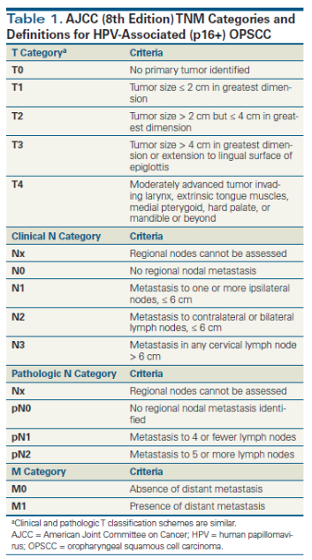
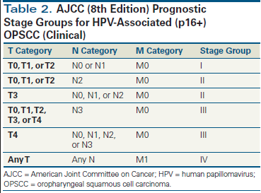
Staging

Slide 10
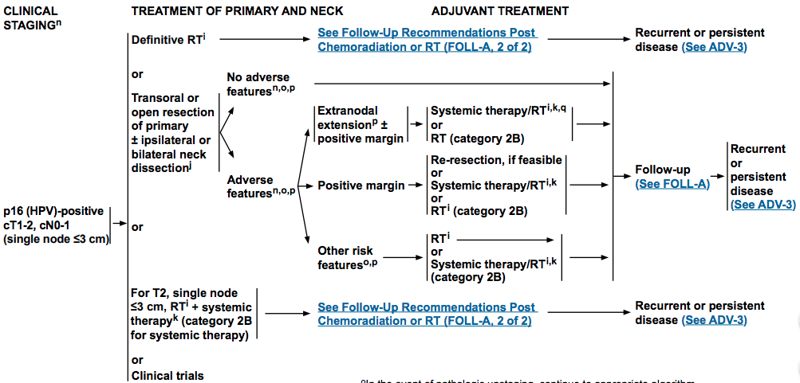
Treatment options

Slide 11
Surgical options
Open Surgery
Trans-oral Robotic Surgery
https://www.youtube.com/watch?v=LTKj7AzAhkw

Slide 12
Risks of surgery
Aspiration
Respiratory compromise
Hemorrhage
Swallowing dysfunction
Wound hematoma
Infection

Slide 13
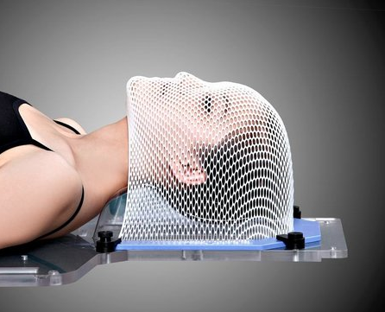
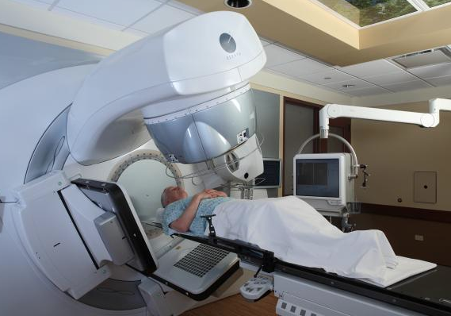
Radiation

Slide 14
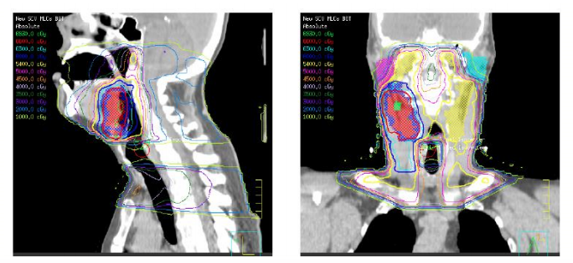
Radiation treatment
6-7 weeks of daily treatments, Monday through Friday

Slide 15
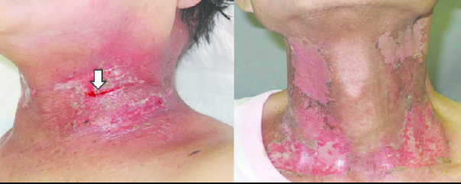
Radiation
Acute side effects: fatigue, sore throat, taste change, hair loss, pain with swallowing, mucositis, dry mouth, thick saliva, red skin and skin peeling, patients sometimes need feeding tubes

Slide 16
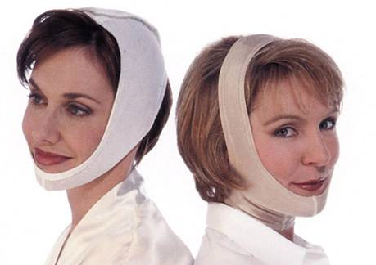
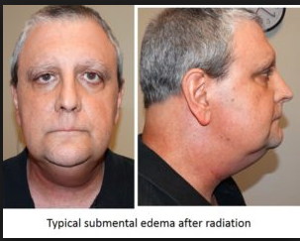
Radiation
Long term side effects: secondary malignancy, chronic difficulty swallowing, chronic dry mouth, chronic taste change, neck fibrosis, neck lymphedema, trismus, osteoradionecrosis and tooth decay

Slide 17
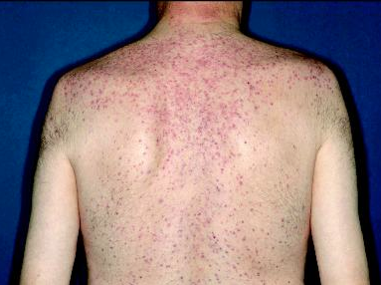
CHemotherapy
Weekly or q3 week cisplatin, cetuximab (EGFR-antibody), carboplatin
Risks of chemotherapy/systemic agents:
Nausea and vomiting
Diarrhea
Fatigue
Renal toxicity
Ototoxicity
Neutropenia
Rash

Slide 18
Multi-Disciplinary care
Medical oncology
Otolaryngology
Radiation Oncology
Dental
Nutrition
Speech Therapy
Social Work
Pathology
Radiology

Slide 19
Follow up
Year 1: Visit with H&N exam/scope q 1-3 mo, PET/CT at 3 mo post-tx
Year 2: Visit q 2-6 mo
Year 3-5: Visit q 4-8 mo
>5 years: Every 12 month visits, as above

Slide 20
Follow up
Speech/hearing and swallow evaluation and rehab
Nutrition evaluation
Ongoing surveillance for depression

Slide 21
Outcomes
Notes:
3 yr OS for HPV+ was 82% vs 57%

Slide 22
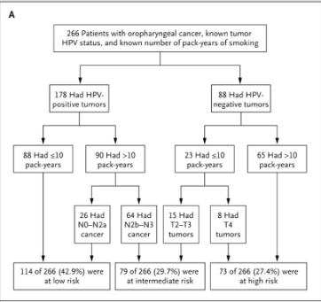
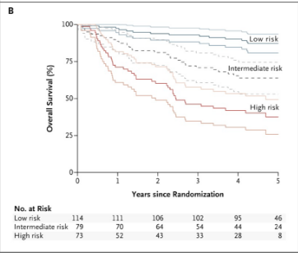
Smoking matters

Slide 23
Cost of treatment
Estimated to be around $140,00 for first two years of treatment
Chronic treatment changes
Trauma from treatment
Compare this to the cost of HPV-vaccination: $390-$450!

Slide 24
Acknowledgments
Dr. John Holland
Dr. Daniel Clayburgh
OHSU and VA multi-disciplinary H&N teams
Dr. Charles Thomas

Slide 25
References
Siegel RL, Miller KD, Jemal A. Cancer statistics, 2018. CA Cancer J Clin. 2018;68(1):7-30.
https://www.cdc.gov/cancer/hpv/statistics/cases.htm
Elrefaey S, Massaro MA, Chiocca S, Chiesa F, Ansarin M. HPV in oropharyngeal cancer: the basics to know in clinical practice. Acta Otorhinolaryngol Ital. 2014;34(5):299-309
http://www.cancernetwork.com/oncology-journal/emergence-novel-staging-system-oropharyngeal-squamous-cell-carcinoma-based-hpv-status/page/0/1. Accessed May 24, 2018
https://www.nccn.org/professionals/physician_gls/pdf/head-and-neck.pdf
https://www.youtube.com/watch?v=LTKj7AzAhkw
Hay A, Migliacci J, Karassawa zanoni D, et al. Complications following transoral robotic surgery (TORS): A detailed institutional review of complications. Oral Oncol. 2017;67:160-166
http://www.aacr.org/Newsroom/Pages/News-Release-Detail.aspx?ItemID=1079#.WwdY1tPwaRs

