Slide 1

Oregon HPV Immunization
Steve Robison
Sentinel Epidemiologist
Oregon Immunization Program

Slide 2
Overview
This presentation is divided into two sections:
Questions about HPV disease and immunization
Oregon-specific data & observations
Question-driven format- so feel free to ask questions!

Slide 3


Questions
When we talk in public we all want to look like this:
But when we ask questions, as speaker or audience, aren’t we afraid we look like this?

Slide 4
Starting Questions
What is HPV?
How long has this been around?
Is it true that everyone gets HPV?
How long does the vaccine last?
Why do we give it to teenagers?
Why don’t we give it to adults?

Slide 5
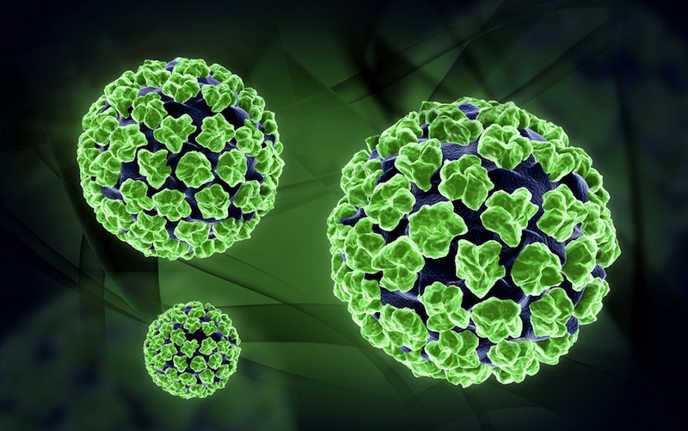
Human Papillomavirus (HPV)
Part of family papillovirdae
Ancient, small, DNA viruses
Very slow mutation rates
Mostly restricted to mammals
At least one fish papillomavirus

Slide 6
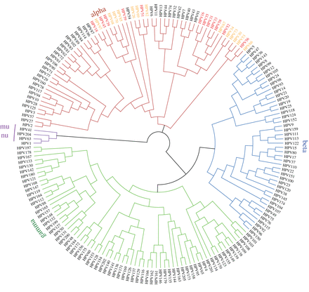
Papillomaviridae
Over 49 genuses and 300 types are known, across humans and animals
At least 200 types are HPV (human)
~40 are spread sexually- target mucosal genital epithelium
A dozen alpha types are known to cause cancer
Another 13 are suspected
McBride AA. Oncogenic human papillomaviruses. Phil. Trans. R. Soc. B. 2017 Oct 19;372(1732):20160273.

Slide 7
Is Everyone Exposed to HPV?
Short answer is ‘yes’- for entire family of HPV viruses
For known cancer causing strains, answer is ‘maybe not’
Research results typically fall into 50% to 80% exposure range for adults by some age.
Actually hard to estimate:
  Most HPV infections are cleared within 6-24 months, typically with little to no development of long term antibodies.
  Exposure study results may vary by prevalence of HPV in populations.
Matthijsse SM, van Rosmalen J, Hontelez JA, et al. The role of acquired immunity in the spread of human papillomavirus (HPV): Explorations with a microsimulation model. PloS one. 2015 Feb 2;10(2):e0116618.
Ryser MD, Myers ER, Durrett R. HPV clearance and the neglected role of stochasticity. PLoS computational biology. 2015 Mar 13;11(3):e1004113.

Slide 8
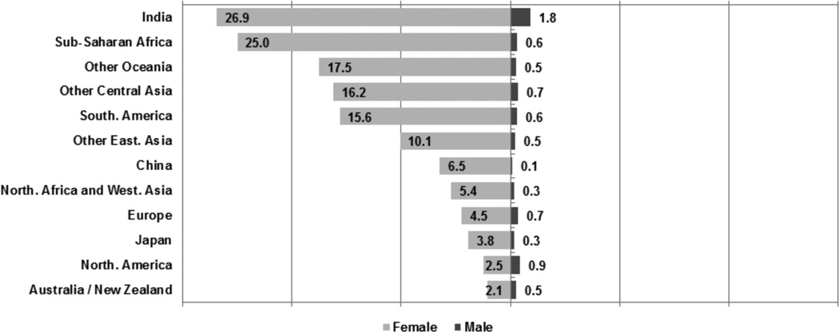
HPV Percent of Cancers Worldwide
Giuliano AR, Nyitray AG, Kreimer AR, et al. EUROGIN 2014 roadmap: Differences in HPV infection natural history, transmission, and HPV-related cancer incidence by gender and anatomic site of infection. International journal of cancer. 2015 Jun 15;136(12):2752.

Slide 9
HPV Vaccination
Vaccination leads to strong levels of antibodies against HPV.
Vaccine protection is orders of magnitude greater than what is created by a ‘natural’ infection.
‘Natural’ infection may also be cleared without developing antibodies.
Evidence to date suggests long-term protection- no substantial drops in protection for the first immunized cohorts seen yet.
Also evidence that only moderate HPV immunization rates still provide herd immunity.
Kavanagh K, Pollock KG, Cuschieri K, et al. Changes in the prevalence of human papillomavirus following a national bivalent human papillomavirus vaccination programme in Scotland: a 7-year cross-sectional study. The Lancet Infectious Diseases. 2017 Dec 1;17(12):1293-302.

Slide 10
Why is HPV for Teenagers?
This is actually a good question.
So why not start older?
  One argument is the need to immunize before any risk of sexual transmission.
  Regardless, a general rule for immunizations is that the earlier started, the better protection and fewer side effects.
Another consideration-
  Young adults are notorious, on their own, for avoiding immunizations.
  Sense of immortality?
  Hard to reach young adults to immunize them.

Slide 11
So Why Not Younger HPV Immunization?
This is very hard to answer- and may be based on manufacturer belief about acceptability, rather than science.
Hepatitis B is on early child schedule- HPV could be too.
As evidence of lifelong duration adds up, this may become a real issue.
Best science would support starting HPV as soon as schedule allows, at age 9.

Slide 12
So Why Not Immunize Adults?
Current recommendation is up to age 26.
But
For adults, even after exposure, still a benefit to immunization
  multiple types of HPV
  non-universal exposure to HPV
  low or no production of antibodies after clearing disease
  long duration of vaccine protection

Slide 13

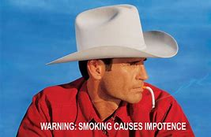

Interlude
Remember this?
This is what I want to see:
Or maybe:
HPV
HPV
Throat Cancer

Slide 14
Oregon Immunization Questions
When do kids start getting HPV immunizations?
Do we have geographic pockets of low HPV immunization?
Is teen reluctance to get multiple shots per visit a factor?
How important is coadministration of HPV with Tdap?
Does ‘vaccine crowding’ affect HPV immunization?
How much variation in clinic HPV practice is there?

Slide 15
Oregon HPV Immunization Initiation

Slide 16
eleven
twelve
thirteen
fourteen
nine
ten

Slide 17
HPV Immunization Initiation by Days of Age, for Oregon 13 to 17 Yr Olds as of May 1st, 2018

Slide 18
Geographic Distribution of HPV Immunization
Questions:
Do we have substantial variation across counties?
Are there smaller geographic pockets of non-immunization?

Slide 20
HPV Initiation by Zipcode, Oregon Ages 13-17, 2018
By Quantiles:
Lightest- LT 50%
Med Light 51 to 61%
Med Dark 61 to 70%
Darkest GT 70%
White=missing/no teens

Slide 21
HPV Initiation by Zipcode, Age 13-17,
(Red Equals Rates Below 40%)
Key
Red- LT 40%
Light Gray 41 to 50%
Med Gray 51 to 60%
Dark Gray GT 61%

Slide 22
Teens- Multiple Shot Reluctance?
Many teens may wish to limit the number of shots they receive per visit.
80% of Oregon teens age 13-17 received multiple shots on one or visit, (among all shot visits post age nine)
98% of teens UTD for HPV had multiple shots per visit
57% of those with multiple shots per visit were HPV UTD vs only 4% of those with only one shot per visit post age nine
Those with any visit with multiple shots were 14 times more likely to be UTD than those who never got multiple shots per visit

Slide 23
Oregon County Rates of Teens Age 13-17 Who Only Receive One Shot per Visit

Slide 24
Coadministration for 13-17 Year Olds
Best opportunity to give other shots is with tdap
49% of Oregon teens aged 13-17 received HPV and tdap on the same visit
However only 31% of Oregon preteens age 11 and 12 received HPV and tdap on the same visit

Slide 25
Coadministration for 12 Year Olds
Focus here is mostly on 13-17 year olds
12 year olds also provide a check on trends
CCO/Medicaid use of HEDIS emphasizes shots by age 12
Overall 22% of 12 year olds were UTD for HPV
40% of 12 year olds had coadministered HPV and tdap
Among those HPV UTD, 78% had coadministered HPV and tdap

Slide 26
Oregon Adolescent Immunizations
Immunization 2016 2017 2018
Tdap 92% 93% 93%
Meningococcal(1+) 65% 75% 77%
Seasonal Influenza 24% 25% 28%
HPV (1+) 62% 65% 67%
HPV UTD (2 or 3) 36% 44% 46%

Slide 27
Another Way to Look at HPV and Tdap
15% of teens 13-17 initiated HPV immunization before tdap
68% of teens 13-17 initiated HPV with tdap
17% of teens 13-17 initiated HPV after tdap
Lesson here- Shouldn’t put off HPV when teens present for tdap.

Slide 28
Immunization Visit Crowding?
Teens are often reluctant to get many shots per visit;
Teens also tend to have limited numbers of provider visits.
So
Is there ‘competition’ for which shots are given first or second at a visit?

Slide 29
Visit Crowding & Tdap
One test- look at HPV UTD rates among those who got HPV along with Tdap, in comparison to those getting MCV with Tdap
67% of teens 13-17 had coadministered tdap and MCV
48% of teens 13-17 had coadministered tdap and HPV
40% of teens 13-17 had coadministered tdap, MCV, & HPV
If only two vaccines given (tdap + X), MCV was 3.3 times more likely to be given as the second vaccine than HPV.

Slide 30
Crowding & HPV UTD
Question- does it matter whether MCV is preferred over HPV for coadministration?
Conclusion: If only one shot is given with tdap, preferring MCV is associated with cutting HPV UTD rates in half.
HPV should always be preferred as the second shot with tdap.

Slide 31
Provider HPV Rates
OIP has a nationally reviewed method for using IIS data to produce more accurate teen immunization rates on geographic levels (county)
However this method can also be used to better estimate clinic denominators and rates.

Slide 35
Next Steps
OIP will look at rates of coadministration across the
Continue to research the effects of ‘vaccine crowding’
Look for ways to leverage information on coadministration, shot limiting, and need for HPV order preference into clinical practice
Questions?

