Slide 1


HPV Impact: Surveillance of HPV-related cervical pre-cancers (CIN2+) in Oregon, 2008-2016
Oregon HPV Summit - May 2018
Nasreen Abdullah, MD, MPH
Sara Ehlers, MPH

Slide 2
Outline of Presentation
Overview of human papillomaviruses and HPV infections
Description of HPV Impact Surveillance System
Preliminary findings
  HPV-related cervical disease in Oregon, 2008-2016
  Prevalence and distribution of HPV types

Slide 3
Overview
Human papillomaviruses
HPV infections

Slide 4
HPV Infection
Most common sexually transmitted disease¹
- Estimated 80 million infected currently in United States
- 14 million new infections annually
Common among adolescents and young adults
- genital warts
- anogenital and oropharyngeal
Estimated 12,360 new cases of cervical cancer
- 4,020 women will die from cervical cancer

Slide 5
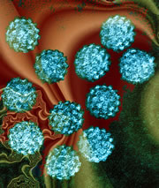
Human Papillomavirus (HPV)
HPV types
(~100)
Mucosal/genital
(~40 types)
Non-mucosal/cutaneous
(~60 types)
Low-risk types
6, 11
High-risk types
16, 18
Skin warts
- hands and feet
-Low-grade cervical abnormalities
-Cancer precursors
-Cervical cancers
-Low-grade cervical abnormalities
-Genital warts
-Laryngeal papillomas

Slide 6
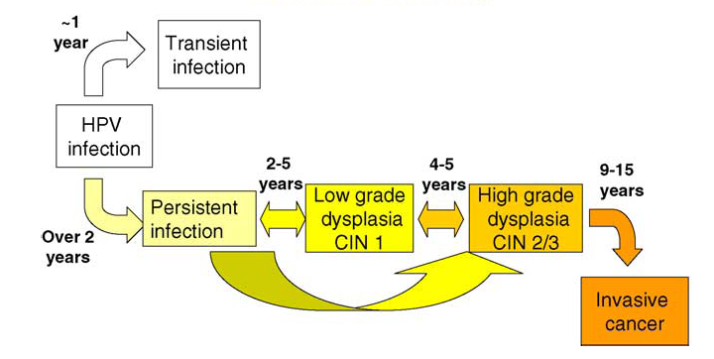


Natural History of HPV Infection

Slide 7
Surveillance
Surveillance System
Methods

Slide 8
What is HPV Impact?
Pinner et al. Cultivation of an adaptive domestic network for surveillance and evaluation of emerging infections. EID. Sept, 2015.
Emerging Infections Program (EIP)

Slide 9
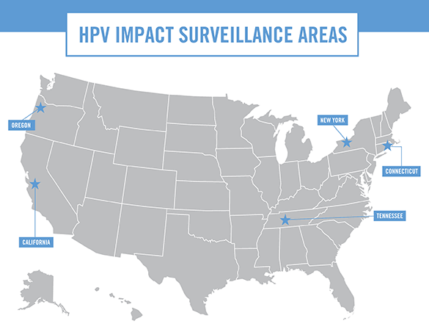

Slide 10
Surveillance Methods – Case Definition
18 years of age or older at time of diagnosis
Resident of 28 zip code area in Portland metro
Has histologically (biopsy) confirmed diagnosis of CIN 2, CIN 2/3, CIN 3, or adenocarcinoma in situ (AIS)
Diagnosed on or after January 1, 2008

Slide 11
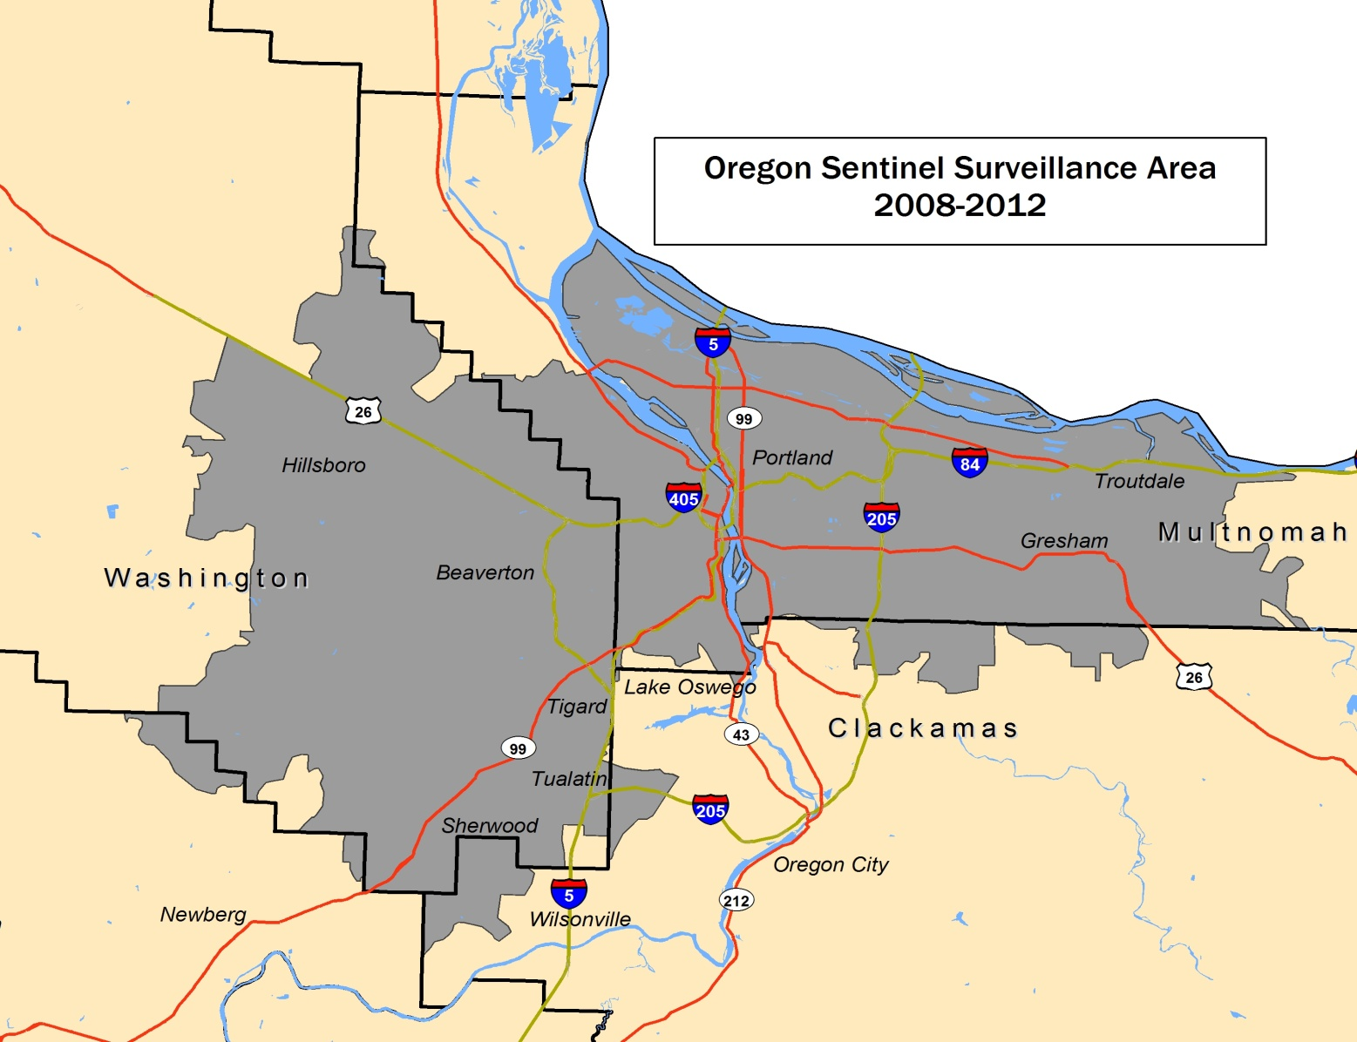
Oregon’s Surveillance Area
Oregon Sentinel Surveillance Area
2008-2016

Slide 12
Surveillance Methods – Data Sources
Data Sources
  - Pathology reports from the labs
  Providers and electronic medical records
  Immunization registry (ALERT)
Specimens – HPV Typing

Slide 13
Methods: HPV Type Testing
We collect and submit tissue from 18-39 year-old cases to CDC for HPV typing
Sample is tested for 41 HPV types by Linear Array (LA) HPV Typing Assay and Line Probe Assay (LiPA) testing
37 HPV types tested are oncogenic
Two oncogenic types - 16/18 - cause 70% of cervical cancer.
Five oncogenic types cause ~15% of cervical cancer.
These seven types are covered by the HPV9 vaccine.

Slide 14


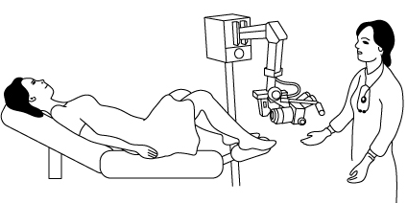





General data flow
HPV 16

Slide 15
Why monitor precancers
To answer questions about vaccine effectiveness
– cervical cancer monitoring is impractical
– dysplasia is a good proxy for cervical cancer
Precancers themselves cost millions for evaluation and treatment

Slide 16
HPV Monitoring Objectives
Determine incidence of high-grade cervical dysplasia
Describe trend in prevalence and distribution of HPV types

Slide 17
Data Results
Incidence of cervical precancers

Slide 18
Incidence Number and Rate of CIN 2+ Cases, Portland Area, 2008-2016
*Data are provisional and not for publication.

Slide 19
Incidence Number of CIN 2+ Cases by Grade, Portland Area, 2008-2016
*Data are provisional and not for publication.

Slide 20
Relative Percentage of CIN 2+ Grades by Race/Ethnicity, Portland Area, 2008-2016
*Data are provisional and not for publication.

Slide 21
Incidence Number and Rate of CIN 2+ Cases, Women Aged 18-39 Years, Portland Area, 2008-2016
*Data are provisional and not for publication.

Slide 22
CIN2+ Incidence Rate Among Women Aged 18-20 Years, Portland Area, 2008-2016
In 2012, ACS pap screening recommendations changed: women under 21 shouldn’t have a pap at all.
*Data are provisional and not for publication.

Slide 23
Percentage of Women Aged 18-20 Years Who Received a Pap Screening, Portland Area, 2008-2016
*Data are provisional and not for publication.

Slide 24
CIN2+ Incidence Rate among Screened Women Aged 18-20 Years, Portland Area, 2008-2016
*Data are provisional and not for publication.

Slide 25
Number and Incidence Rate of CIN 2+ Among Women Aged 21-24 Years, Portland Area, 2008-2016
In 2012, ACS pap screening recommendations changed: 21-29 year old women should have a pap every 3 years(as opposed to every year), HPV Test only if abnormal Pap
*Data are provisional and not for publication.

Slide 26
Percentage of 21-24 year old women who received a Pap Screening, Portland Area, 2008-2016
*Data are provisional and not for publication.

Slide 27
Incidence Rate of CIN 2+ Among SCREENED Women Aged 21-24 Years, Portland Area, 2008-2016
In 2012, ACS pap screening recommendations changed: 21-29 year old women should have a pap every 3 years(as opposed to every year), HPV Test only if abnormal Pap
*Data are provisional and not for publication.

Slide 28
Incidence Rate of CIN 2+ Among Women Aged 25-29 Years, Portland Area, 2008-2016
In 2012, ACS pap screening recommendations changed: 21-29 year old women should have a pap every 3 years(as opposed to every year), HPV Test only if abnormal Pap
*Data are provisional and not for publication.

Slide 29
Percentage of Women Aged 25-29 Years Who Received a Pap Screening, Portland Area, 2008-2016
*Data are provisional and not for publication.

Slide 30
Incidence Rate of CIN 2+ Among SCREENED Women Aged 25-29 Years, Portland Area, 2008-2016
In 2012, ACS pap screening recommendations changed: 21-29 year old women should have a pap every 3 years(as opposed to every year), HPV Test only if abnormal Pap
*Data are provisional and not for publication.

Slide 31
Summary
The data show us
  The percentage of women receiving Pap smears declined in all age groups
  For women aged 18-24 years:
    CIN 2+ rate declined
    CIN 2+ rate for screened women declined
  For women 25-39 years:
    CIN 2+ rate remained same or increased
    CIN 2+ rate for screened women increased
CIN 2+ incidence has decreased in the cohorts of women that include vaccine recipients.

Slide 32
Data Results
Prevalence & distribution of HPV Types

Slide 33
Number of women aged 18-39 years with HPV typed CIN 2+, by age group and HPV vaccination status, Portland Area, 2008–2015
*Data are provisional and not for publication.

Slide 34
Number of HPV Types, CIN 2+ in Women Aged 18-39 Years, Portland Area, 2008-2015
*Data are provisional and not for publication.

Slide 35
Percentage of HPV Types by Vaccination Status for Women Aged 18-39 Years with CIN 2+, Portland Area, 2008–2015
Vaccinated:
*Data are provisional and not for publication.

Slide 36
Percentage of HPV Types by Vaccination Status for Women Aged 18-39 Years with CIN 2+, Portland Area, 2008–2015
Vaccinated:
*Data are provisional and not for publication.

Slide 37
Percent HPV Types by Race/Ethnicity, CIN2+ Cases in Women Aged 18-39 years, Portland Area, 2008–2015
*Data are provisional and not for publication.

Slide 38
Summary of HPV Typing Data
Type distribution:
  50% HPV types 16/18
  25-30% 6/11/31/33/45/52/58
  These pre-cancers are preventable!
HPV Type Distribution by vaccination status
  Vaccinated women less likely to have type 16/18 than unvaccinated women
  Vaccinated women more likely to have types not covered by vaccines than unvaccinated women
  Data to come for types covered by nanovalent vaccine (widely in use in 2016)

Slide 39
Conclusion
Next Steps
Conclusion

Slide 40
Next steps
Expand surveillance to include histologically-confirmed cervical cancer
  Collect data on the full spectrum of HPV-associated cervical disease
  Establish population–based typing of invasive cervical cancer
  Compare HPV types in precancer and cancer in the same population
Considering changing the catchment area from 28 zip code spanning two counties to Multnomah County
  Easier to find sources of population (denominator data), particularly for race/ethnicity data

Slide 41
Conclusion
Data are confusing, but vaccine appears to be having a positive impact on CIN 2+ rates
Oregon’s data are similar to national HPV Impact 2008-2015 data
  CIN 2+ rates declined in 18-24 year old women
  The percent of women screened for cervical cancer decreased across all age groups and sites
  CIN 2+ rates declined among screened women 18-24 years old
  CIN 2+ rates increased among screened women aged 25-39

Slide 42
Questions?
Project Coordinator and Epidemiologist: Nasreen Abdullah, MD, MPH: Nasreen.Abdullah@state.or.us
Research Analyst, Sara Ehlers, MPH: Sara.J.Ehlers@state.or.us
PSET, Informatics & HPV Manager, Melissa Powell, MPH: MELISSA.E.POWELL@state.or.us
THANK YOU!

Slide 43
Extra Informational Slides

Slide 44
Number and Incidence Rate of CIN 2+ Among Women Aged 30-39 Years, Portland Area, 2008-2016
In 2012, ACS pap screening recommendations changed: Women 30-65 years old should have a Pap every 5 years with HPV co-test OR a Pap every 3 years no HPV co-test
*Data are provisional and not for publication.

Slide 45
Percentage of Women Aged 30-39 Years Who Received a Pap Screening, Portland Area, 2008-2016
*Data are provisional and not for publication.

Slide 46
Incidence Rate of CIN 2+ Among SCREENED Women Aged 30-39 Years, Portland Area, 2008-2016
*Data are provisional and not for publication.

