Slide 1
The Current HPV Vaccination Landscape and Emerging Opportunities
Jesse Nodora, DrPH
Assistant Professor
Dept. of Family Medicine and Public Health
UC San Diego Moores Cancer Center
jnodora@ucsd.edu

Slide 2
Human Pappilomavirus (HPV)

Slide 3
How small is a virus?

Slide 5
HPV Types and Vaccines

Slide 6
What We Will Cover
Overview of the HPV landscape
Priorities for improvement
A call to action: key activity to reach optimal HPV vaccination coverage
Constituents & their roles
Approaches
Resources

Slide 9
Global HPV
“Cervical cancer affects over half a million women each year, and kills a quarter of a million.
One woman dies of cervical cancer every two minutes, making it one of the greatest threats to women’s health.
Each one is a tragedy, and we can prevent it.”
Dr. Tedros Adhanom Ghebreyesus Director-General Cervical Cancer: An NCD We Can Overcome Intercontinental Hotel, Geneva 19 May 2018

Slide 10
HPV in the USA
https://www.cdc.gov/cancer/hpv/statistics/cases.htm

Slide 11
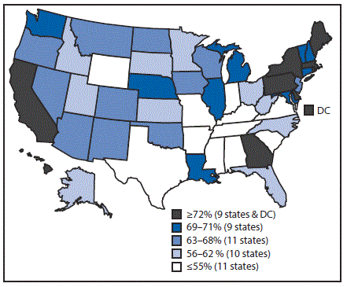
FIGURE 2. Estimated vaccination coverage* of ≥1 dose of human papillomavirus vaccine† among female adolescents aged 13–17 years§,¶ —National Immunization Survey–Teen, United States, 2016
Abbreviation: DC = District of Columbia.
* National coverage = 65%.
† The Advisory Committee on Immunization Practices recommends nine-valent, quadrivalent, or bivalent HPV vaccine for females.
§ Sample size = 9,661.
¶ Includes female adolescents born during January 1998–February 2004.
Walker TY, Elam-Evans LD, Singleton JA, et al. National, Regional, State, and Selected Local Area Vaccination Coverage Among Adolescents Aged 13–17 Years — United States, 2016. MMWR Morb Mortal Wkly Rep 2017;66:874–882. DOI: http://dx.doi.org/10.15585/mmwr.mm6633a2.

Slide 12
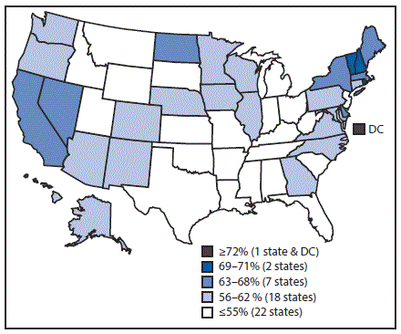
FIGURE 3. Estimated vaccination coverage* of ≥1 dose of human papillomavirus vaccine† among male adolescents aged 13–17 years§,¶ — National Immunization Survey–Teen, United States, 2016
Abbreviation: DC = District of Columbia.
*National coverage = 56%.
† The Advisory Committee on Immunization Practices recommends nine-valent or quadrivalent HPV vaccine for males.
§ Sample size = 10,814.
¶ Includes male adolescents born during January 1998–February 2004.
Walker TY, Elam-Evans LD, Singleton JA, et al. National, Regional, State, and Selected Local Area Vaccination Coverage Among Adolescents Aged 13–17 Years — United States, 2016. MMWR Morb Mortal Wkly Rep 2017;66:874–882. DOI: http://dx.doi.org/10.15585/mmwr.mm6633a2.

Slide 13
HPV Vaccination in Oregon
63% of adolescent (13-17) girls in Oregon have
received one or more doses of HPV vaccine (U.S. 65%)
61% of adolescent (13-17) boys in Oregon received one or more doses of HPV vaccine (U.S. 56%)
Walker TY, Elam-Evans LD, Singleton JA, et al. National, Regional, State, and Selected Local Area Vaccination Coverage Among Adolescents Aged 13–17 Years — United States, 2016. MMWR Morb Mortal Wkly Rep 2017;66:874–882. DOI: http://dx.doi.org/10.15585/mmwr.mm6633a2. (2016 Data)

Slide 14
American Cancer Society (ACS) West Region Statewide HPV Vaccination Rates
Region/State | Females |  | Males
 | ≥1 HPV†† | HPV UTD§§ | ≥1 HPV†† | HPV UTD§§
U.S. overall | 65.1 % | 49.5% | 56.0% | 37.5%
California | 78.0 | 58.3 | 67.3 | 40.3
Hawaii | 71.7 | 61.5 | 58.3 | 46.9
Nevada | 64.6 | 43.0 | 65.1 | 37.0
Alaska | 61.9 | 47.8 | 60.3 | 39.1
Oregon | 62.6 | 50.3 | 60.9 | 44.7
Washington | 70.9 | 55.2 | 58.9 | 44.0
Guam | 76.9 | 55.8 | 58.5 | 33.2
Estimated vaccination coverage with selected vaccines and doses* among adolescents aged 13–17 years,† by HHS region, state, selected local area, or territory — National Immunization Survey–Teen, United States, 2016. https://www.cdc.gov/mmwr/volumes/66/wr/mm6633a2.htm?s_cid=mm6633a2_e

Slide 15
HPV Vaccination Is Safe, Effective, and Provides Lasting Protection
HPV Vaccine is SAFE
Benefits far outweigh any potential risks
Safety studies findings for HPV vaccination are reassuring and similar to MenACWY and Tdap vaccine safety reviews
HPV Vaccine WORKS
Population impact against early and mid outcomes have been reported in multiple countries
HPV Vaccine Protection LASTS
Studies suggest that vaccine protection is long-lasting
No evidence of waning protection

Slide 16
Value Parents Place on the Vaccines
Adapted from Healy et al. Vaccine. 2014.

Slide 17
Reasons parents won’t initiate HPV vaccination for children
Stokley et al. MMWR. 2014.

Slide 18
HPV Vaccine: Working together for a final push towards high HPV vaccine coverage for everyone
Mark H. Sawyer, M.D.
Professor of clinical pediatrics
UC San Diego School of Medicine and Rady Children’s Hospital San Diego

Slide 19
Missed opportunities: How did we solve this for early childhood vaccines?
Tools for improving coverage
AFIX-assessment, feedback, incentive, exchange (CDC)
Standing orders for vaccine
HEDIS-what gets measured gets done
Reminder Recall
Public campaigns

Slide 20
What do we need to do to push the rates up?
Educate doctors and the community about HPV vaccine
Show doctors how well (or not well) they are immunizing their patients
Expose pediatricians to the outcomes of HPV infection
Address concerns about waning immunity
Address concerns about vaccine safety
Teach doctors how to communicate about HPV vaccine in a time-efficient manner

Slide 21
What do we need to do to push the rates up?
Take sex out of the equation-make this all about cancer
Stick to the cancer message
Make it routine
Consider lowering the age of vaccination-Vaccine is licensed starting at the age of 9 years
Emphasize HEDIS measure
(2 doses of HPV with different dates of service and 6-12 months between doses on or between the 9th and 13th birthdays.)

Slide 22
What do we need to do to push the rates up?
Take doctors out of the equation
Standing orders
Nurse-only visits
Alternative sites for immunization (Pharmacies, Schools)

Slide 23
What do we need to do to push the rates up?
Use proven strategies
Cultivate champions
Don’t treat HPV differently from any other vaccine-strong recommendation from providers
Prompts for the computer electronic health record

Slide 24
What do we need to do to push the rates up?
Put money into the equation
Pay for performance
HEDIS and other quality measures

Slide 25
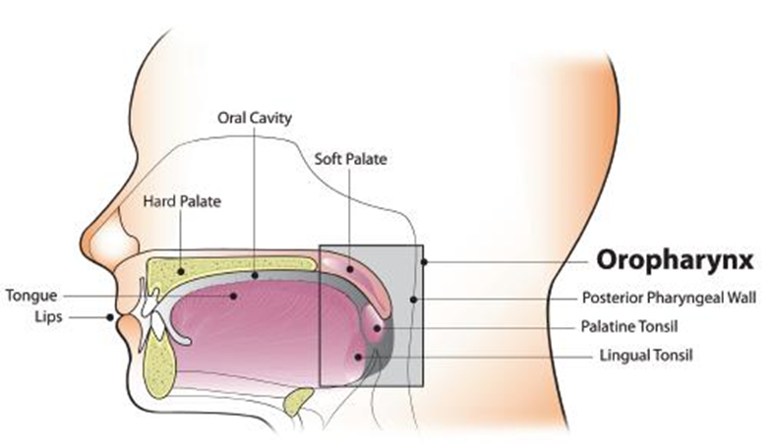
Dental Health Care Providers & Cancer of Oropharynx
Oropharyngeal cancer
(Oropharynx-back of the throat, including the base of the tongue and tonsils)
https://www.ada.org/en/~/media/EBD/Files/DENTAL-Action-Guide-WEB_ADA

Slide 26
The Problem and Solution
70% of Oropharyngeal cancers are attributed to HPV (11,600 of 16,479 yr.)
HPV Roundtable and American Dental Association say: “Educate patients and parents of age-eligible children about the link between HPV and oropharyngeal cancers, and advocate for HPV vaccination as cancer prevention.”
Know Your Unique Role (link HPV, Oral health, promote HPV Vax)
Practice cancer prevention (educate)
Refer patients for vaccinations
Collaborate (pediatricians, primary care)
Engage your team (train)
Create a pro-immunization environment (visuals)
https://www.cdc.gov/cancer/hpv/statistics/cases.htm
https://www.ada.org/en/~/media/EBD/Files/DENTAL-Action-Guide-WEB_ADA
https://www.aap.org/en-us/Documents/AAP_OPCHPV_WhatDentalProsNeedToKnow_final.pdf

Slide 27
American Cancer Society Mission: HPV Cancer Free Raquel Arias, MPH American Cancer Society

Slide 28
Campaign Launch Week: June 4-8, 2018
The American Cancer Society will use our comprehensive resources to prevent HPV Cancers.

Slide 29
Mission: HPV Cancer Free
https://youtu.be/S_nNo_vhMsk

Slide 30
Mission: HPV Cancer Free Campaign Goals
Increase HPV vaccination rates for preteens
Increase national HPV vaccination series completion rates among 13-year-olds to at least 80% by June 8, 2026.
Increase each state’s HPV vaccination series completion rate among 13 to 17 year-olds to their initiation rate of meningococcal vaccination among 13 to 17 year-olds by June 8, 2026.
Eliminate gender disparity and reduce geographic disparities in HPV vaccination
Increase male HPV vaccination series completion rates among 13-year-olds to that of females nationally and in each state by June 8, 2026.
Increase HPV vaccination rates in geographic locations lagging behind the national average.

Slide 31
5 Key HPV Vaccination Strategies
Strengthen Provider Recommendations
Activate Partners and Stakeholders
Know Your Data and Track Progress
Implement Evidence-Based Interventions and Systems Changes
Increase Parental Knowledge

Slide 32
Key Audiences
Providers & Health Systems (Continue)
Parents (New!)
Parents/Guardians of 9-12 year olds
Parents/Guardians of teens
Family members who influence health decisions
Volunteers (New!)
Existing ACS volunteers
Recruit clinical champions, HPV cancer survivors, caregivers, and parent champions

Slide 33
Key Audience: Providers & Health Systems
Continue supporting evidence-based interventions within health systems:
FQHCs
Hospital Systems
Health Plans
Partner with key stakeholders
Forming a State HPV Vaccination Roundtable as a platform for collaboration in OR
Recruiting Provider Champions

Slide 34
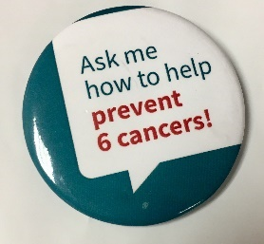
Key Audience: Parents & Volunteers (New!)
ACS Regional teams are developing customized campaign strategies
Training & Engaging all ACS staff
Public advertising campaign
Piloting integrating HPV Vaccine education into ACS Community Events (e.g. Relay For Life)
August 2018: Volunteer Champion Training (Survivors, Caregivers, Parents)

Slide 35
Take these actions to stand with ACS:
Endorse, share, and support the American Cancer Society goal to vaccinate 80% of 13 year olds by 2026.
Visit www.cancer.org/HPV and follow and share American Cancer Society social media posts on Facebook, Twitter, and Instagram.
Partner with the American Cancer Society on the five key campaign strategies.
Join existing HPV coalitions, roundtables, or workgroups. These groups are planning and leading HPV vaccination improvement work across their state.

Slide 36
Key Resources
CDC:
HPV- https://www.cdc.gov/hpv/index.html
https://www.cdc.gov/hpv/hcp/answering-questions.html
ACS:
Parent/Public facing materials (Mission: HPV Cancer Free) www.cancer.org/hpv
Access the Steps guide online: http://bit.ly/HPVStepsActionGuide
National HPV Vaccination Roundtable www.hpvroundtable.org
Action Guides- http://hpvroundtable.org/action-guides/

Slide 37
Key Resources-Cont.
AAP:
https://www.aap.org/en-us/advocacy-and-policy/aap-health-initiatives/immunizations/HPV-Champion-Toolkit/Pages/HPV-Champion-Toolkit.aspx
Dental: https://www.ada.org/en/~/media/EBD/Files/DENTAL-Action-Guide-WEB_ADA
Pharmacy: http://hpv.pharmacist.com/
Community Tool Box: https://ctb.ku.edu/en
https://ctb.ku.edu/en/table-of-contents/overview/model-for-community-change-and-improvement/community-tool-box-overview/main

Slide 38
THANK YOU!
jnodora@ucsd.edu

