Slide 1
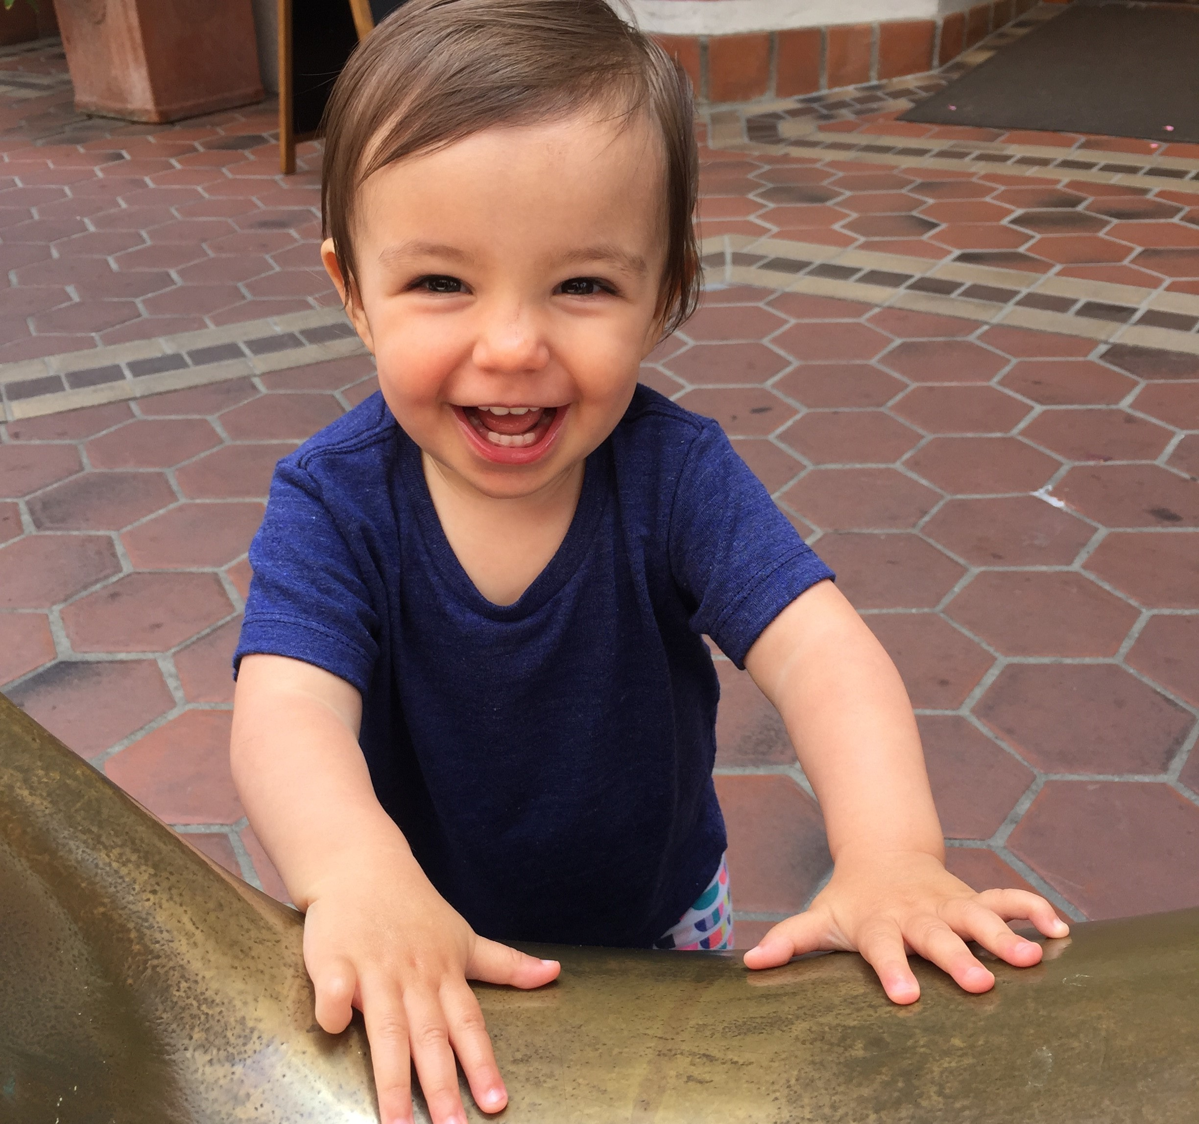
Improving HPV rates at the clinic level
Rex Larsen
Vaccines for Children Program Coordinator

Slide 2
What are we going to talk about today?
What do HPV rates look like in Oregon?
What impacts rates at the clinic level?
How can we improve rates?
What might work at your clinic?

Slide 3
What do HPV vaccination rates look like in Oregon?

Slide 4
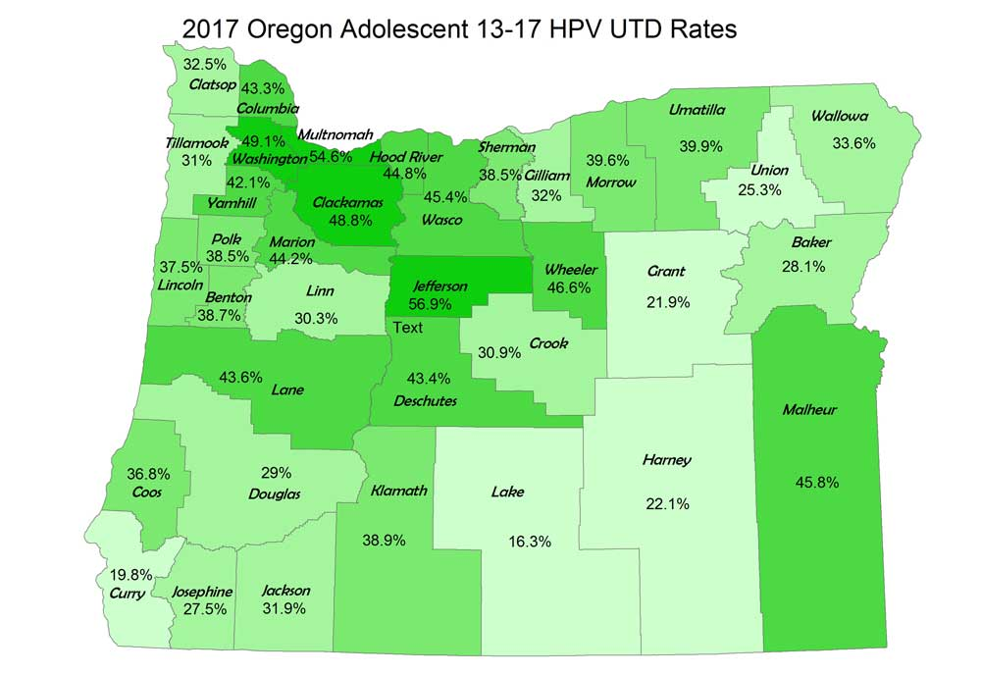
Notes:
Statewide the rate is 44%, but you can see that ranges from a low in the mid teens, to highs in the mid fifties.

Slide 5
Why are rates so low?

Slide 6
What factors influence HPV vaccination rates at the clinic level?
Parental hesitancy
Provider recommendations
Lack of immunization opportunities
Competing priorities at adolescent well care visits
Lack of demand for the vaccine among adolescents

Slide 7
Provider recommendations and parental hesitancy

Slide 9
Lack of immunization opportunities

Slide 10
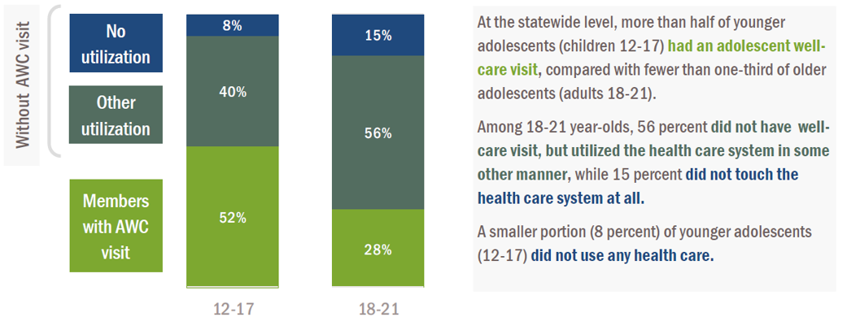
Adolescent well child visits
Notes:
Only about half of all 12-17 year-olds had their annual well care visit. The older adolescents get, the worse this number gets.

Slide 11
Strategies to improve HPV vaccination rates break down into two categories
Make the most of immunization opportunities.
Create new opportunities to immunize.

Slide 12
1. Make the most of existing immunization opportunities.

Slide 13
Make the most of immunization opportunities
Make a strong recommendation
Implement systems to make sure that you never miss an opportunity to vaccinate

Slide 14
Make a strong recommendation
Sandwich HPV between other adolescent vaccines
Use a presumptive approach
Make a personal recommendation
Direct the conversation to cancer prevention
Emphasize the value of starting early
Be prepared to answer questions

Slide 15
What does a strong recommendation look like?
“Today Erik is due for Tdap, HPV, and Meningococcal vaccines. “
“I vaccinated my own children for HPV.”
“HPV vaccine prevents cervical cancer, and some types of head and neck cancer.”
“because the immune response is stronger in younger children, only two doses are required if we start Sasha today.”

Slide 16
How to implement this change
Identify providers that make strong recommendations in your practice
Have a peer coaching event at a clinical team meeting
Role play in pairs
Hold each other accountable with continued discussion between providers

Slide 17
Chart flags and provider reminders
Establish a policy to vaccinate at all visits.
Scrub charts before visits and forecast immunizations
Implement reminders for HPV vaccine in EHR or appointment notes for providers
Have education materials available for parents when they check in

Slide 18
2. Create new opportunities to immunize

Slide 19
Create new opportunities to immunize
Convert non well-care visits to well care visits
Identify patients who are behind and bringing them in
Recall patients for their second dose

Slide 20
Convert non-well care visits
What types of care are adolescents seeking?
Acute care visits
Sports physicals
What needs to be done to convert these visits to well care visits?

Slide 21
Convert non-well care visits
Train front-desk staff to check for most recent well care visit when they receive calls
Determine what services need to be added to sports physicals

Slide 22
Immunize at acute care visits
What kinds of acute care visits are you comfortable immunizing at?
Determine what types of visits represent a true contraindication to vaccination.
Offer immunizations for visits involving sub-acute illness.
If a parent is hesitant, be flexible, schedule a well care visit before they leave the office.

Slide 23
Identify patients that are behind and bring them in
EHR or ALERT IIS based reminder recall.
Have staff call in patients to schedule a well care visit, not just immunizations.
Perform recalls on a schedule to tailor the work to the time you have available.

Slide 24
Recall patients for their second dose
Schedule the appointment for the second dose, before the patient leaves the office.
Maintain a call back schedule for staff scheduling appointments so it isn’t up to parents to remember.

Slide 25
What might work in your clinic?
Make the most of existing immunization opportunities.
Create new opportunities to immunize.

Slide 26
Questions?

