Slide 1
HPV Education and Prevention in Oregon Schools and Communities
Moderator
L. Kris Gowen, PhD, EdM
Panelists
Sasha Grenier, MPH, CHES
Jamie Smith, MPH, BSN, RN, NCSN
Caitlin Dickinson, MPH

Slide 2
HPV in Schools
Vaccine mandates are widely considered effective
Rhode Island, Virginia, and Washington DC have school HPV vaccine mandates
included opt-out provisions that did not apply to other vaccinations
10 states have mandates about HPV education
Oregon is in the middle of national HPV vaccination rates

Slide 4
Oregon Law
The Human Sexuality Education Law (2009)
The Healthy Teen Relationship Act (2013)
The Child Sexual Abuse Prevention Law (2015)

Slide 5
Oregon Health Education Standards: STIs

Slide 6
School-based Sex Ed is prevention
Comprehensive Sex Ed has been shown to prevent STIs, sexual violence and promote health, well-being, and safety.

Slide 7
Comprehensive Sex Ed Curricula
Rights, respect, responsibility: a K-5 Sexuality Education Curriculum
My Future, My Choice: A Middle School Curriculum
FLASH: A Middle and High School Curriculum

Slide 8
School Health Programs
Oregon Administrative Rule 581-022-2220
The school district shall maintain a prevention oriented health services program for all students which provides...
Communicable disease control...
Integration of school health services with school health education programs and coordination with health and social service agencies, public and private.

Slide 9
School nurses
Educate students and parents and staff on sexual health and wellness
Prevent and control the spread of communicable disease
Provide education on and keep records of immunizations

Slide 10
School nurse shortage

Slide 11
School Based Health Centers

Slide 12
Quotes from school nurses
“I recently copied the CDC's page on HPV statistics, wrote a letter outlining some other current trends I researched and sent one home to all parents. I encourage the students to get vaccinated and beyond that I feel it is really up to the parents.” –School Nurse
“My general approach when I find out a student is sexually active, is to talk to them about the importance of preventing pregnancy and STD transmission.”– School Nurse
“Due to my caseload of over 3,000 students, I don’t have time to educate students/families on STD’s and HPV. If staff/parents/students ask me about it, I always recommend the vaccine.”– School Nurse

Slide 13
Quotes from educators
I am a high school health teacher and do teach specifically about HPV… but honestly, (the kids don’t know this but) it’s because of and based on personal experience. I do not use any specific curriculum – I just weave what I’ve learned from my own health care providers into my regular, disease-prevention instruction. One big barrier to effectively teaching about it is that there still appears to be a lot of unknown/conflicting information about it. For example, it sounds like there are still some questions about how it is spread (ex: Through a condom or not?), how long it can last (ex: Can it return after it is “cleared”?), how it affects men (ex: Is it really just a cosmetic issue (warts) and “spreading” issue… but otherwise doesn’t really affect them? Or is there more?), and how safe/effective the vaccine actually is. “ – HS teacher

Slide 14
Quoted from others
“Another challenge is that the age range when we first begin talking about HPV is 11-12 when Tdap is also due. I get referrals from schools during immunization exclusion time in February and some of those parents tell me “the school says she/he only needs Tdap” when I bring up CDC guidelines of Meningococcal, HPV and flu vaccine. I sometimes wish schools would acknowledge to parents/families that their medical provider may recommend other vaccines during their visit, not just the school-required vaccines.” – Community Nurse
“This may be a gap in knowledge. From our sexual health curriculum programs, I don't think we really talked about this vaccination. [Our county Public Health Department received] grant funds to reduce HPV.... I don't think there was a focus on school educators providing this information.” – Public Health Manager

Slide 15
Local activities, challenges, & potential solutions
Caitlin Dickinson, MPH
Project Manager, RAVE | Cancer Control Coordinator, HPV P30
Oregon Rural Practice-based Research Network

Slide 16
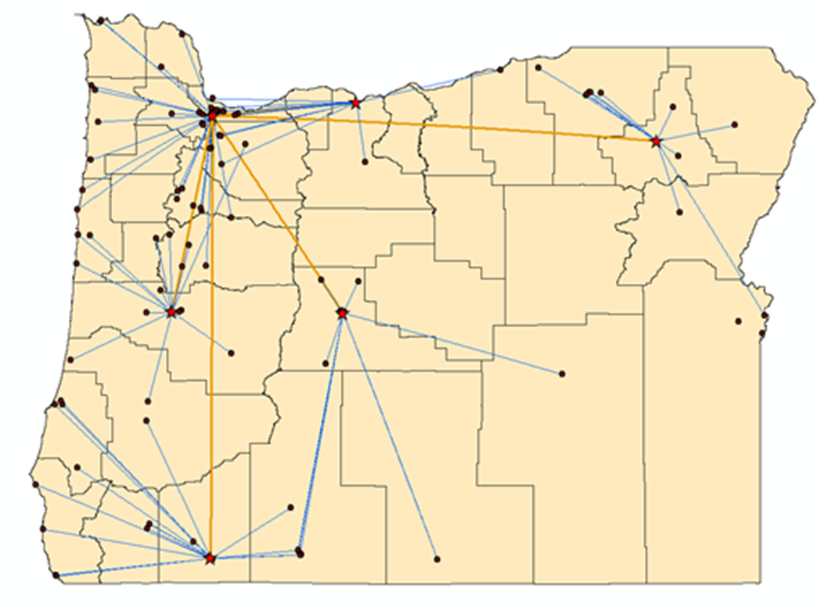
Oregon Rural Practice-based Research Network
To improve the health of rural Oregonians by promoting knowledge transfer between communities and clinicians.
Notes:
281 practices, 26 counties
700 providers (FM, IM, Peds, NP/PA)
Unique adult patients: ~500,000
Annual adult Encounters: 800,000 +
EHRs: EPIC, Athena Health, Greenway

Slide 17
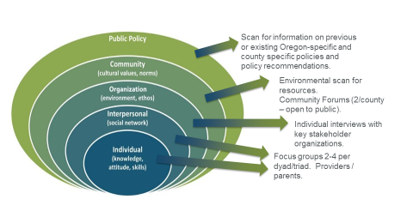
HPV Vaccination in Oregon (HPV P30); Detecting Geographic/Racial Disparities, Inequities and Population Mores
Principal Investigator: Jackilen Shannon, PhD
Institution: Knight Cancer Institute, OHSU
Project Dates: July 1, 2017 – June 30, 2018
We seek to conduct environmental scans in seven rural counties that reflect dyads or triads of geographically similar counties and which have very divergent HPV immunization coverage. We will identify both barriers and facilitators to full vaccination among adolescents and ideally approaches to improvement that may be most easily shared across rural regions.

Slide 18
The Rural Adolescent Vaccine Enterprise (RAVE)
Principal Investigator: Lyle “LJ” Fagnan, MD
Institution: Oregon Rural Practice-based Research Network, OHSU
Project Dates: July 1, 2018 – June 30, 2023
HPV is linked to many cancers. Though there is a vaccine that can prevent the spread of HPV infection, vaccination rates fall far short of desired targets. The Healthy People 2020 Goal for completion of the vaccine series by age 13 to 15 years is 80%, yet only 40% of females and 21% of males currently complete it.
This comprehensive intervention study will shed new light on how rural communities and primary care practices can improve immunization rates.
Baseline assessment
18 month PCP intervention
Community-level intervention
Toolkit
Study Design
Notes:
Although the HPV vaccine has been available for over a decade and has demonstrated effectiveness in preventing precancerous changes in the cervix, anus, and oral cavity, we fall far short of achieving the Healthy People 2020 goal of 80% completion of the vaccine series by ages 13-15 years. The national completion rate is less than 50% of the CDC Benchmark; in rural Oregon, the county-level HPV completion rate is 27.8%. To improve HPV vaccination rates, it is necessary to change practice behavior and knowledge in Oregon communities about the vaccine . In partnership with the State of Oregon Immunization Program and 40 participating primary care practices in rural Oregon, the RAVE research team at the Oregon Rural Practice-based Research Network (ORPRN) will increase the capacity of practices to sustain a quality improvement (QI) structure and processes that lead to improved immunization rates. ORPRN Practice Enhancement and Research Coordinators will act as facilitators, and will provide boots-on-the-ground support for the practice QI team. The findings from RAVE will improve HPV immunization rates across rural Oregon and will be shared across rural America.
Aim I: A baseline assessment of how rural primary care practices, public health programs, and community-based organizations are addressing completion of the HPV vaccine series. The assessment will include direct observation of workflows, validated measures of team-based care effectiveness, and practice-level knowledge of HPV and current HPV vaccine recommendations.
Aim II: A stepped-wedge cluster randomized trial design, to test the effectiveness of a multi-component PCP-based intervention on completion of the HPV vaccine series and reduction in rates of missed opportunities to vaccinate. The intervention will include practice facilitation to engage clinics to redesign patient care and communication strategies to optimize HPV vaccine completion, and a practice improvement model designed to firmly establish reminder and recalls systems and standing orders.
Aim III An evidence-based community-level intervention to study HPV vaccination uptake and completion. PCPs will select a partnering community-level organization such as a Community Advisory Council (CAC), patient and family advisory group, or local public health program. Together, the clinic and community group will implement an evidence based community-level intervention designed to improve knowledge among adolescents and their parents on HPV, cancer risk, risk reduction via vaccination, and the safety and effectiveness of the vaccine series. Lastly,
Aim IV: A toolkit – shared with practices, state public health programs, and CCOs – shares promising clinical and community intervention features.

Slide 19
Setting: HPV P30 & RAVE
In rural Oregon,
county-level completion of the HPV vaccine
series is only 27.8%.
Rural areas have unique challenges
regarding HPV and are understudied
Less access to pediatricians
Lower health literacy
Belief systems
Minding the Gap: Tdap vs. HPV Rates, Oregon 2016 data
“I think there's a lot of education that needs to be done, especially I think in some of our rural communities. There's definitely a different expectation, especially around what is education as far as sexual health, and what the parents are willing to allow and definitely a different environment.” – HPV P30, Key Informant Interview

Slide 20
Potential solutions
Discuss HPV and HPV vaccination in health class(es)
Encourage students to take ownership of their health
“They keep dropping classes all the time, but if they have a health class I would think that those are things that should be brought up in health.”
“Whenever the school brings up some issue, oh, my god! The parents, some parent or other or two or three parents get their panties in a wad and they, they're in trouble. ‘That's a personal issue. I don't want my child knowing about sex or they're not doing that, I don't want you talking about it. They shouldn't know that now. They're too young.’ And so, I don't know if the school should be doing it. I would personally like for them to. Maybe one class at the school. Like I say, if they're still doing a health class, I think that would be perfect to have a whole section on the pathology of diseases and how HPV, what it is, what it can cause, that kind of thing. I think that'd be great, but maybe no place else.”
– HPV P30, Key Informant Interviews

Slide 21
Potential solutions
Discuss HPV and HPV vaccination in health classes
Frame vaccine as cancer prevention
“If the parent says, well I don't want to, you know, give my child permission to have sex. I say, first of all, your child doesn't ask you for permission to have sex, and, second of all, as far as they're concerned, this doesn't have to have anything to do with sex.”
“…parents identify the HPV vaccine as preventing a sexually transmitted virus, they have different emotions and belief systems around it and so the conversations that I have will frequently-I talk a lot about cancer prevention as a way of make-like reframing that conversation.”
– HPV P30, Key Informant Interviews

Slide 22
Potential solutions
Have pop-up clinics in school setting at different times of year
Staff nurse at least 1/week in schools
Allow time for this individual to vaccinate!
Have an immunization stand at back-to-school night
Encourage schools to release HPV vaccination information in newsletters

Slide 23
Potential solutions
Strongly encourage students to receive vaccine during receipt of school-required vaccines
“I think it's an important time just 'cause they're in for the other two, you know, school recommended shots, so you have a better chance of, I think, getting them to do it at that visit.”
– HPV P30, Key Informant Interview
Support creating new SBHCs

Slide 24
Thank you!
Caitlin Dickinson, MPH
Project Manager, H2N & RAVE | Cancer Control Coordinator, HPV P30
Oregon Rural Practice-based Research Network
Oregon Health & Science University
3181 SW Sam Jackson Park Road
Portland, Oregon 97239
summerca@ohsu.edu | 503-494-9106

