Slide 1
Preventing HPV-Associated Cancers:
Increasing Teen HPV Vaccination
Katrina Hedberg, MD, MPH
Health Officer & State Epidemiologist
May 31, 2018

Slide 2
Overview
HPV-related diseases
HPV-disease burden in US and Oregon
Oregon HPV immunization rates
  Trends
  Demographic, geography
  Clinic type
Addressing barriers to HPV immunization

Slide 3
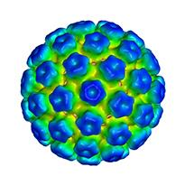
Human Papillomaviruses
>100 types
Not cancer-causing
Cancer causing
Notes:
More than 100 different human types have been characterized.
Most do not cause cancer.
They cause cause genital warts, mildly abnormal Pap smears, growths on the larynx, skin warts, or no lesions at all.
About 15 types cause cancer. Two types that are prevented by the original HPV vaccines, 16 and 18, caused about 75% of cervical cancer in the US. Cancer causing HPV types also cause head and neck tumors as you’ll learn later in addition to anal, vaginal, vulvar and penile cancers.

Slide 4
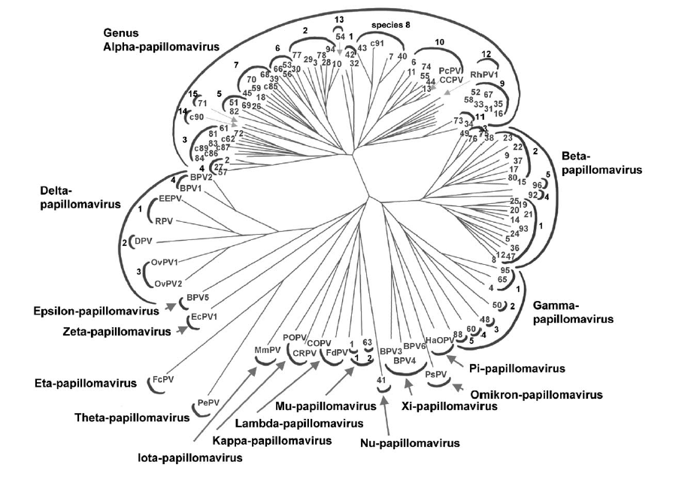

A7
A9
Notes:
Like insects animals plants and bacteria, the many interrelated papillomaviruses are grouped into genuses, species. Human papillomavirus species A9 and A7 have the most cancer-causing types.

Slide 5
HPV Types Differ in their Disease Associations
~40 types
Mucosal
sites of infection
Cutaneous
sites of infection
~80 types
High risk (Oncogenic)
HPV 16, 18
Low risk (non-oncogenic)
HPV 6, 11
Cervical cancer
Anogenital CA
Oropharyngeal CA
Cancer precursers
Common hand and foot warts
Genital warts
Laryngeal papillomas
Low grade cervical dz
Notes:
More than 100 different human types have been characterized.
Most do not cause cancer.
They cause cause genital warts, mildly abnormal Pap smears, growths on the larynx, skin warts, or no lesions at all.
About 15 types cause cancer. Two types that are prevented by the original HPV vaccines, 16 and 18, caused about 75% of cervical cancer in the US. Cancer causing HPV types also cause head and neck tumors as you’ll learn later in addition to anal, vaginal, vulvar and penile cancers.

Slide 6
HPV-infection
Most females and males will be infected with HPV at some point in their lives
  ~ 79 Million Americans currently infected
  14 Million new infections/ year in US
  HPV infection most common in teens and early 20’s
Most people will never know they have been infected

Slide 7
Cancers caused by HPV per year, US, 2009-2013
Cancer Site | % caused by HPV | Female | Male | total
Cervix | 91% | 10,600 | 0 | 10,600
Vagina | 75% | 600 | 0 | 600
Vulva | 69% | 2,500 | 0 | 2,500
Penis | 63% | 0 | 700 | 700
Anus | 91% | 3,200 | 1,600 | 4,800
Rectum | 91% | 500 | 200 | 700
Oropharynx | 70% | 2,000 | 9,600 | 11,600
Total |  | 19,400 | 12,100 | 31,500

Slide 8
Cancers Attributable to HPV by Sex, Cancer Type, United States, 2010–2014
https://www.cdc.gov/cancer/hpv/statistics
Notes:
This slide shows the number of HPV-Associated Cancer cases that were diagnosed and reported each year in United States from 2010 to 2014 (the most recent 5-year period with available data) by sex, cancer type, and HPV-type.
Cancer registries do not routinely collect data on whether HPV is in the cancer tissue. So, to estimate the number of HPV-associated cancers, researchers look at cancer in parts of the body and cancer cell types that are likely to be caused by HPV. These include all carcinomas of the cervix and squamous cell carcinomas of the vagina, vulva, penis, anus (including rectal squamous cell carcinomas), and oropharynx, which is the back of the throat, including the base of the tongue and the tonsils. Additionally, in this analysis, all cancers were microscopically confirmed.
A CDC study published in 2016 used population-based data to genotype HPV types from cancer tissue. These data are used to estimate the percentage of these cancers that are probably caused by HPV, what we call HPV-attributable cancers.
This graph shows the total number of HPV-associated cancers and uses the attributable fractions from the genotyping study to estimate the number probably caused by HPV types. HPV types were grouped as 16/18 (the dark blue bar), other high risk types 31/33/45/52/58 (the medium blue bar), and other HPV types (light blue bar). The white bar means that HPV DNA was not detected.

Slide 9
HPV-Associated Cancers, by Sex,
Race / Ethnicity, US, 2010–2014
https://www.cdc.gov/cancer/hpv/statistics
Notes:
This graph shows the incidence of all HPV-associated cancers (all carcinomas of the cervix and squamous cell carcinomas of the vagina, vulva, penis, anus [including rectal squamous cell carcinomas], and oropharynx) by sex, race and ethnicity. “Incidence rate” means how many people out of a given number get the disease each year. Incidence rates of HPV-associated cancers varied by sex and race or ethnic group. The rate for women is shown in the solid bar and the rate for men is shown in the hatched bar.
In each race/ethnic group, women had higher rates than men.
Among women, blacks and whites had higher rates and Asian/Pacific Islanders had lower rates compared with other racial groups.
Among men, whites had the highest rates and Asian/Pacific Islanders had the lowest rates compared with other racial groups and non-Hispanics had higher rates than Hispanics.

Slide 10
HPV cancers in Oregon,
2014-2015
Notes:
Oregon State Cancer Registry 2014-2015 data.
Site and histology code
Cervix: Site (C53.0-53.9), histology (8010-8671, 8940-8941)
Vagina: Site (C52.9), histology (8050-8084, 8120-8131 )
Vulva: Site ( C51.0-C51.9), histology (8050-8084, 8120-8131 )
Ano-rectal: Site (C21.0-21.8, C20.9, histology (8050-8084, 8120-8131 )
Penis: site (C60.0-C60.9), histology (8050-8084, 8120-8131 )
Oropharynx: (C01.9, C02.4, C09.0-09.9, C14.2, C02.8, C10.2, C10.8, C10.9, C14.0, C14.8), histology (8050-8084, 8120-8131)
Oropharyngeal site include base of tongue and lingual tonsil, tonsil (including waldeyer ring) and other oropharynx site
Ano-rectal site includes rectum, anus, anal canal, cloacogenic zone, and overlapping lesion of rectum, anus and anal canal.

Slide 11
Cervical and oropharyngeal cancer trends in Oregon, 2000-2015
Notes:
Incidence rate for cervical cancer in Oregon- Trend in 2000-2015
Incidence rate for oropharyngeal cancer in Oregon- trend in 2000-2015 (both men and women)
*Rates are per 100,000 and age-adjusted to the 2000 US Std Population (single ages to 84 - Census P25-1130) standard.

Slide 12
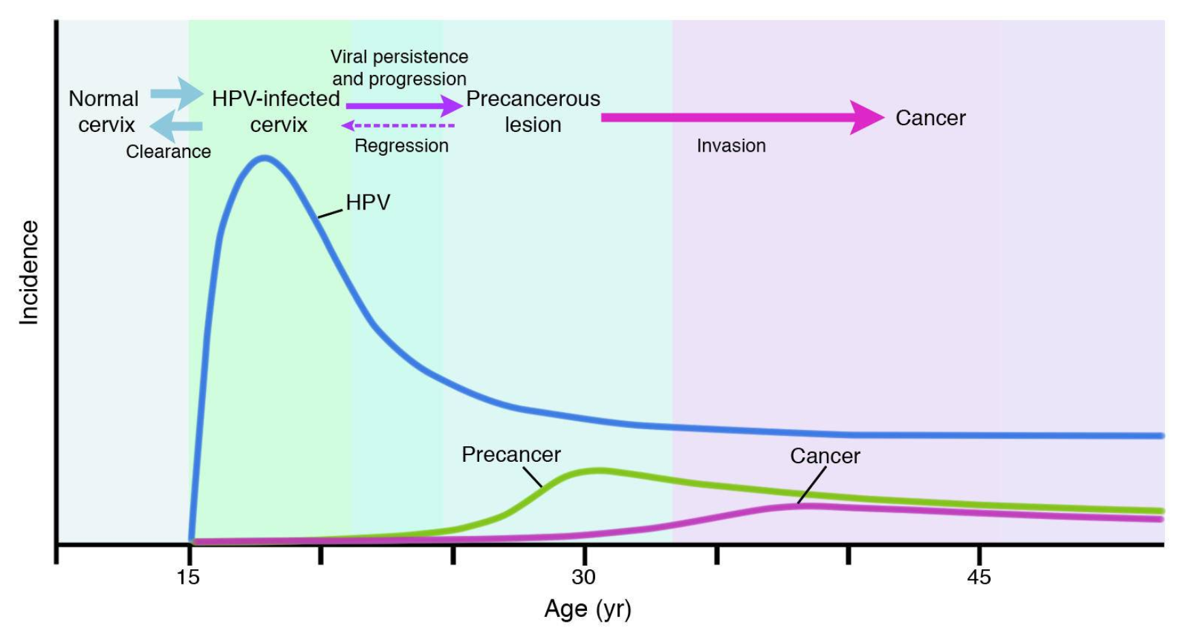
Timeline of HPV infection to cervical cancer development
Lowry DR, Schiler JT. Prophylactic HPV vaccines. J Clin Inv. 2006;116(5)
Notes:
Altogether interval from infection to cancer takes many years.
Here’s another schematic of the typical time course of events starting at the time women begin to have vaginal intercourse.
HPV infections are very common. Approximately 50% of women will have had at least one cervical or vaginal HPV infection within 2 years of first vaginal intercourse and over 80% will have at least one of these infections in their lifetime.
Nearly all resolve completely on their own without even being recognized.
In a small number of cases infections persist and the first pre-cancers appear 2 to 10 years after exposure.
Even at this point most will resolve, but left untreated, invasive cancer will occur within 5 to 25 years in a few of these women with precancers (CIN 2 and 3).

Slide 13
HPV impact monitoring
Early outcomes (years)
HPV prevalence
Genital warts
Mid outcomes (yrs to decades)
CIN/ precancers
Late outcomes (decades)
HPV-associated cancers

Slide 14
HPV-related conditions
Major cause of cervical dysplasia:
  1.4 million new cases of low grade dysplasia in US
  330,000 new cases of high-grade cervical dysplasia in US
  3500 cases of high-grade dysplasia in women 21-29 yrs in Oregon

Slide 15
Why monitor pre-cancers?
Changes in cancer incidence occur only decades after vaccine introduction
Pre-cancers a necessary intermediate step to cancer
Pre-cancers cost $ millions for evaluation and treatment
Notes:
Why monitor precancers instead of cancer itself?
Because cancer develops over a long interval after initial infection, changes in cancer incidence are not expected to be seen for decades after vaccination began.
Pre-cancers are a necessary intermediate step to cancer and occur often enough to serve as a reliable and useful surrogate.
Pre-cancers themselves cost millions for evaluation and treatment. Reducing them is an important goal in its own right.

Slide 16
CIN 2+ among women aged 18-24 years by year of diagnosis, Portland, Oregon
Rate per 100,000 women screened

Slide 17
Notes:
This graph depicts the annual number of CIN2+ diagnoses in woman aged 18–20,by year from 2008 through 2014.
This is the youngest group for which we have CIN2+ reports and this group is most likely group for which we have data, to have been vaccinated.
Most of those who were 18–20 in 2008 probably had not been vaccinated, but by 2014, a lot of 18 year-olds had received at least one HPV vaccine.
And the number of reported new diagnoses per 100,000 population in this age group obviously fell.
That’s encouraging

Slide 18
Women with CIN 2+, by age and HPV vaccination status,
Portland, Oregon, 2008–2015

Slide 19
Women with HPV pre-cancers,
by age & HPV vaccination status,
Portland 2008–2016
N=1728
Notes:
We have received reports of several thousand pre-cancer cases and sent tissue from 1728 to CDC for HPV typing.
Only 40 cases in women under 21 have been typed because as we’ve seen here Pap smears aren’t regularly done now in this age group and few pre-cancers were diagnosed. Many more cases among women 21–29 and 30–39 have been typed.
Also, completely unvaccinated women prevail by about 3 or 4 to one in women under 30 and by a much larger amount in the older women. This is true for all cases, not just those for which HPV typing is available.
The reasons are if, as expected, the vaccine prevents pre-cancer, we’d expect to see fewer vaccinated women among our cases.
Also most of the women with cases were past the recommended age for vaccination of 11 to 13 when the vaccine was introduced.
Finally, uptake of the vaccine has been less than complete.

Slide 20
Adolescent Vaccination Coverage
United States, 2006-2016
Notes:
As you can see, the rates of first and third dose of HPV vaccine are not nearly as high as the coverage rates for the other vaccines routinely recommended for 11 and 12 year olds. However, the very important piece of information that this slide provides is that the strong coverage rates for Tdap vaccine demonstrate that not only are most preteens and teens getting to the doctor, but they are also getting at least one of the recommended adolescent vaccines.

Slide 21
Oregon ALERT IIS
Oregon has a nationally recognized approach to assessing adolescent immunization rates
ALERT Immunization Information (ALERT IIS) is used for teen rates
Oregon rates are assessed as of May 1st of each year

Slide 22
Teen Immunization Rates, Oregon 13-17 year-olds
Immunization 2016 2017 2018
Tdap 92% 93% 93%
Meningococcal(1+) 65% 75% 77%
Seasonal Influenza 24% 25% 28%
HPV (1+) 62% 65% 67%
HPV UTD (2 or 3) 36% 44% 46%

Slide 23
Teen Immunization Rates, Oregon 13-17 year-olds
Immunization 2016 2017 2018
Tdap 92% 93% 93%
Meningococcal(1+) 65% 75% 77%
Seasonal Influenza 24% 25% 28%
HPV (1+) 62% 65% 67%
HPV UTD (2 or 3) 36% 44% 46%

Slide 24
HPV Immunization 1+ Dose Oregon 13-17 Year-olds

Slide 25
HPV Immunization Initiation for Oregon 11-12 Year Olds

Slide 26
Up-to-date HPV vaccination by year

Slide 27
HPV Vaccination by Race/Ethnicity Oregon 13-17 Year Olds, 2018

Slide 29
HPV vaccination initiation and completion
By clinic type
By provider type
In Medicaid patients

Slide 30
HPV UTD by Payer,
Oregon 13-17 year-olds, 2018

Slide 31
HPV initiation and completion
Clinic Snapshot
Notes:
This graph displays figures generated from the Oregon Immunization Program’s quality Improvement program, AFIX – Assessment, Feedback, Incentive, eXchange. The AFIX programs works with clinics over a year to develop and implement strategies to improve immunization rates. The numbers above are from a clinic in Marion County participating in the AFIX program.
The graph shows adolescent rates at the initial visit (first time numbers generated through the AFIX program) , adolescent rates 6 months after rate review, the entire Marion county immunization rates, and missed opportunities (when a patient is given. This data is from a clinic in Marion County.

Slide 32
HPV Immunization Increases
Shift to a 2/3 dose schedule increased HPV UTD rates for 13-17 year olds
Initiation of HPV didn’t substantially increase for 13-17 year olds
BUT
Initiation among tweens (11-12 year olds) increased

Slide 33
Parents of unvaccinated girls – reasons for not starting HPV vaccine series
Stokley et al. MMWR. 2014.
Notes:
Studies consistently show that a strong recommendation from you is the single best predictor of vaccination for any vaccine, including HPV vaccine. In the 2013 NIS-Teen nearly 15% of parents who said that they would not be getting their child vaccinated against HPV in the next 12 months, identified not receiving a recommendation as one of the top reasons not to vaccinate.

Slide 34
Barriers to HPV vaccination initiation
Provider Recommendation practices
  less emphasis on HPV than other vaccines
Parent Hesitancy
  feeling the vaccine is not necessary
Accessibility
  – fewer preventive care visits
Notes:
1. Parent Hesitancy – lack of knowledge and feeling the vaccine is not necessary
Delaying vaccinations is a problem because vaccination helps ensure protection before potential risk of infections, which is the purpose of all vaccines and recommended timeline for HPV vaccine corresponds to the already existing series – Tdap and Meng – initiation of HPV during these visits because as teens age preventative care visits are less frequent.
2. Provider recommendation practices – less emphasis than other routine adolescent vaccines
3. Accessibility – adolescents and young adults are less likely to seek out preventive care

Slide 35
Barriers to HPV vaccination completion
Lack of recommendation by clinician
Missed opportunities for vaccination
Lack of reminder recalls for adolescents
Cost of vaccination
Notes:
Missed opportunities for vaccination – vaccine not offered at acute care visits
No standard practice in place for recalling patients when due for a vaccine aka reminder recalls
Cost of the vaccination – including payment for vaccines outside the medical home and by out-of-network or non-physician providers .
Parents whose children start the HPV vaccine series may forget or might not be aware that their children need to receive 2- 3 separate doses of the vaccine.
Many parents who got their children vaccinated said they did so because a doctor recommended it.
https://www.ncbi.nlm.nih.gov/pmc/articles/PMC4716467/

Slide 36
Opportunities for HPV vaccination
SAME WAY, SAME DAY
Consider HPV vaccination of teens when other family members getting vaccinated
Alternate sites for vaccination
  Pharmacies
Acute care visit: same day vaccination
Notes:
Providers with high HPV vaccination rates presented the vaccine as a routine adolescent vaccine with proven safety to prevent cancer.
Capture community missed opportunities for vaccination

Slide 37
Ensure ALL Patients are Protected
Align office/clinic policy with mission
  Immunize at every opportunity
  Implement standing orders
  Reminder and recall
Align communication with mission
  Cancer-prevention mission
  Common talking points
Know coverage rates
  Clinic-level AND clinician-level
www.cdc.gov/hpv/downloads/Top10-improving-practice.pdf

Slide 38
Population-level HPV Prevention and Control
Track HPV infections and related cancers
Increase HPV-related knowledge and awareness
Increase HPV vaccine supply and use
Ensure HPV vaccine is effective and safe
Improve screening and medical care for HPV infections and related cancers

Slide 39
Oregon Public Health Division
HPV-Related Activities
Oregon State Cancer Registry
Screenwise: providers who offer cervical cancer screening
Breast and Cervical Cancer Treatment Program (BCCTP): treatment coverage
Monitor CIN 2+
HPV Impact
Vaccines for Children:
  Vaccine Implementation
  Vaccine Coverage
ALERT
  Vaccine administration
Oregon Comprehensive Cancer Control Program (OCCCP)
Oregon Immunization Program (OIP)
HPV
School Based Health Centers (SBHCs)
Youth Sexual Health Program
Vaccination screening
Education
Immunization Policy Advisory Team (IPAT)
Education
Immunization policy
39
Notes:
HPV Impact: The HPV Impact program helps track HPV-related Cervical pre-cancers to assess the effect of HPV vaccine before they become cancer. HPV Impact also tests tissue samples for different types of HPV to assess what types of HPV are common in Oregon.
The Oregon Immunization Program (OIP): The Oregon Immunization Program (OIP) works to reach and maintain high immunization rates in Oregon. This occurs through work with immunizing providers, partnership development and vaccine tracking.
Vaccines for Children (VFC): OIP supplies HPV vaccine through the Vaccines for Children (VFC) program. VFC provides vaccines at no cost for qualified groups through age 18 years. Qualified groups include Medicaid-eligible, uninsured, American Indian/Alaskan Native and underinsured children and adolescents. About half of children in Oregon can get vaccines through VFC.
ALERT: OIP tracks vaccine use in Oregon through the ALERT Immunization Information System (ALERT IIS). ALERT IIS includes immunization records for all people in Oregon. It tracks the number of HPV vaccine doses given in Oregon each year. ALERT IIS also tracks the total number of adolescents who get HPV vaccine each year. ALERT IIS reminds health care providers that HPV vaccine can be given as early as 9 years of age. ALERT IIS also helps health care providers know who needs HPV vaccine by showing when it is due.
The Oregon Youth Sexual Health Plan, coordinated by the statewide Teen Pregnancy Prevention/Adolescent Sexual Health Partnership (TPP/SHP), a coalition of state, county and community advocates and non-profit organizations, is a holistic action plan to address all aspects of youth sexual health
The Immunization Policy Advisory Team (IPAT), established in 1999, advises the Oregon Public Health Immunization Program on the development, prioritization and implementation of immunization policy issues. Composed of voting members who are experts in immunization and/or policy fields and non-voting members from the Oregon Health Authority, IPAT strives to facilitate a sound, collaborative decision-making process around immunization issues facing Oregonians
Oregon School-Based Health Centers (SBHCs) are medical clinics that offer primary care services at schools. There are currently 68 certified SBHCs that provide clinical preventive services including immunizations and well-child visits. SBHCs are important and effective providers of HPV vaccinations to adolescents. Vaccine series completion rates among those who received the HPV vaccine at an SBHC are higher than the general population.
The Breast and Cervical Cancer Treatment Program (BCCTP) provides funding assistance to eligible women in need of cancer treatment. Women who qualify do not need to be enrolled in Breast and Cervical Cancer Screening Services in order to access BCCTP.
The Oregon Comprehensive Cancer Control Program (OCCCP) works alongside other chronic disease prevention programs to support state and community initiatives through policy, systems and environmental approaches. OCCCP works collaboratively with multiple public health, health system, community, and advocacy partners at the local, state, and federal levels to address the modifiable root causes of cancers, improving screening rates and community-clinical linkages for at-risk populations, and improve the health and quality of life for cancer survivors.
The Oregon State Cancer Registry (OSCaR): OSCaR is a statewide, population-based registry that collects and analyzes information about cancer diagnosed in Oregonians. Reportable cancers include HPV-related cancers.
ScreenWise: ScreenWise is a statewide network of providers offering breast cancer, cervical cancer and heart disease screenings and diagnostic services to low income women living in Oregon. The ScreenWise mission is to reduce breast cancer, cervical cancer, heart disease and other chronic diseases by promoting early detection, screening, and risk reduction support.

Slide 40

Questions?
Public Health Division

