Slide 1
Improving Immunization Rates in Clatsop County:
A Quality Improvement Project
May 2018
Steven Blakesley Clatsop County PH
Dawn Bergeson Clatsop County PH

Slide 2
Success with 13 year-olds

Slide 3
Agenda:
Why Clatsop County?
Quality Improvement
Questions and Discussion

Slide 4
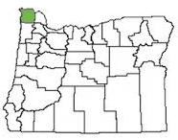
~37,000 residents

Slide 5
Some of the Highest HPV Cancer rates

Slide 6
Low HPV Vaccine Completion Rates

Slide 7
Existing HPV initiatives
Oregon Rural and Tribal Advisory Board participant
Small stipend for outreach
Nurses began researching and discussing approach

Slide 8
HPV Rate Push Pull Strategy
Community Pull:
Parent Outreach
High School Outreach
Public showings “Someone you Love”
Media Campaign
Radio
Print
Social
HPV Vaccination Rates
Provider Push:
Education
Provider groups
Data Clean
ALERT
AFIX

Slide 9
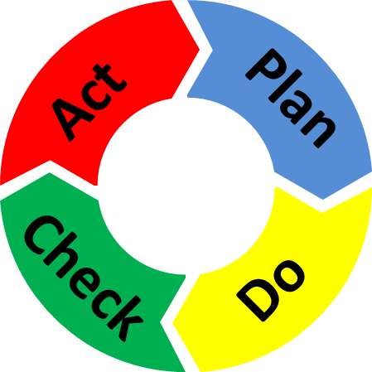
Quality Improvement Model Used

Slide 10
QI Focus Areas
Establish reliable baseline for immunization rates
HPV Vaccination Systems and Strategies Inventory 2.0
AFIX Assessment
Improve Electronic Medical Record keeping
Utilize consistent messaging and reminders

Slide 11
Clean-up Oregon ALERT IIS.
Oregon ALERT IIS Staff Patient Inactivation Criteria:
11-12 year olds=7 years since last visit
13-17 year olds=5 years since last visit
Clatsop County (CCDPH) Patient Inactivation Criteria:
1 time visit with CCDPH and numerous PCP vaccine visits
Out of area addresses and 2 years since last visit with CCDPH

Slide 12
AFIX Assessment
Assessment, Feedback, Incentive, Exchange
AFIX is a quality improvement program used by awardees to raise immunization coverage levels, reduce missed opportunities to vaccinate, and improve standards of practices at the provider level. Assessment of the healthcare provider's vaccination coverage levels and immunization practices

Slide 13
Goal for AFIX
Raise immunization rates for 11-17 year olds by 5% in six months

Slide 14
Consistent messaging and Processes

Slide 15
Letters
Credit parents for making the important first step
Inform them the next dose is due for full protection
Let them know this will complete the series
Remind them that HPV infection is a known cause of several types of cancer, Enclose a flier
Give phone number for questions or to make an appointment
Notes:
We can not be sure why the varying degree of success with the letters. The first group was younger and the initial dose was more recent. The decision to vaccinate at the time may have been more though out as opposed to just grouped in with other vaccines given years ago. We know who we sent letters to and will make a note in their EMR. When they come into the clinic again we can ask some of them why?

Slide 16
Letter Success
Initial letter targeting our 13 year-old patients
50% response rate
Second letter sent to patients who only need 1 more dose prior to age 15
<1% response rate
Third letter sent to all others age 13-17
No responses

Slide 17
Consistent Process
Begin using the new Vaccine Administration Record (VAR)
”Does your child receive vaccinations somewhere other than this health department?”
Often marked yes during School Exclusion
Not all PCPs carry certain vaccines
Appointments are 1-2 months out
School Exclusion 2018 one time visits were 44%

Slide 18
Consistent Messaging - Provider
Talk to ALL age appropriate patients about HPV
Offer the same way we offer required vaccinations.
Example: Your child is due for Tdap, Meningococcal and HPV today I will go draw those up. Using the word “due” rather than required or recommended.
Track refusals in patients EMR
Bring reasons/barriers to monthly Nurse/Admin meeting to
Provide materials to parents who are hesitant and offer to make follow-up contact with them
Encourage patients to make their follow-up appointment at check out.
Add the next due date to the check out/follow-up notes.

Slide 19
Consistent Process - Admin.
Include ALERT record in chart for all 9-26 year-olds
The HPV conversations with parent or patients start at the appointment scheduling and at check-in
Offer to make their next HPV appointment at check out.
Add the next due date to their appointment reminders in EMR

Slide 20
Tracking Outreach
When HPV is forecast on ALERT Admin staff add this label to the encounter form
Admin staff will mark if it comes up in conversation. If it is not marked the Provider will ask and mark.
What prompted you to start/complete the HPV series today?
___Received a letter; ___Reminder Call ___Provider; ___Radio; ___T.V.; ___Facebook; ___Blog ___Other

Slide 21
NEW TOOLS
Exhibit A: Decision making tool
Exhibit B: Spreadsheet
Exhibit C: Vaccine Administration Record
Exhibit D: Labels to add to encounter forms
Exhibit E: Letters
Exhibit F: Examples of posts on Facebook page
American Cancer Society Tools
ACS Systems and Strategy Inventory
ACS QI Readiness Assessment

Slide 22
Questions and Discussion

Slide 23
Contact Info
QI and Data - Dawn Bergeson dbergeson@co.clatsop.or.us 503-325-8500
Outreach – Steven Blakesley sblakesley@co.clatsop.or.us 503-338-3750
Immunization Coordinator – Chel Baker cbaker@co.clatsop.or.us 503-338-3683

